Slide 1
Classification
Stage 3
Qiannan Zhang
qiannan.zhang@kaust.edu.sa
Notes:
He y I like to introduce my work on classification

Slide 2
Pipeline
Data preprocessing
Text Representation
Training the classifier
Predicting
Evaluation
Tuning

Slide 3
Classify Conferences
Venue: Knowledge Discovery and Data Mining Dataset 11
Year: 2009-2011
Papers: 752
Venue: IEEE Transactions on Knowledge and Data Engineering Dataset 16
Year: 2009-2012
Papers: 586

Slide 4
Preprocessing
On words: split, stem, filter
On missing values: filled up by paper titles
Dataset 11:
442 Feature Engineering and Classifier Ensemble fo...
468 Ontology-Based mining of brainwaves: a sequenc...
471 Mutually reinforcing systems
488 Sellers' problems in human computation markets

Slide 5
Two ways, two sets
Naïve Bayes
Linear SVM
Randomly sampling training and testing set
Compare

Slide 6
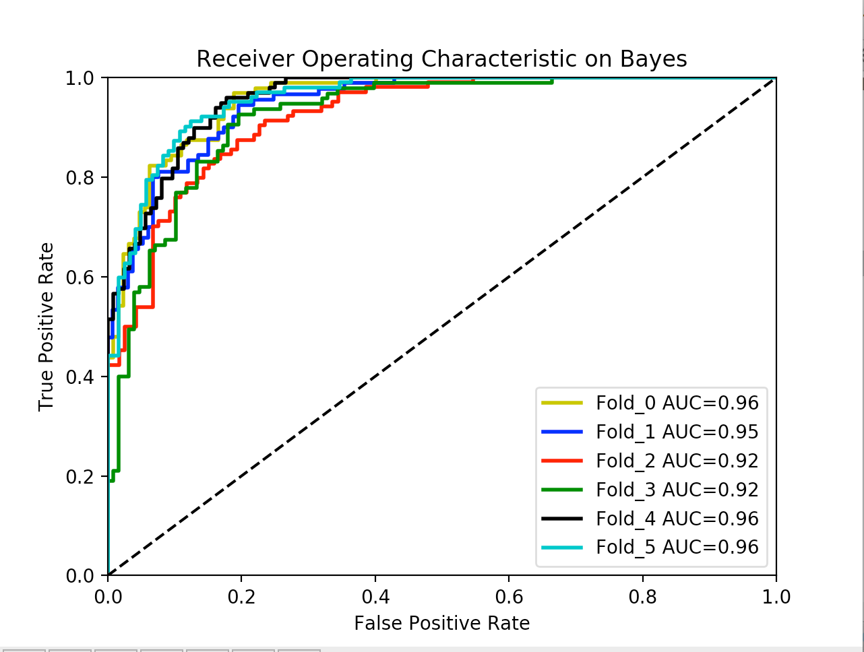
K fold validating
Every iteration, choose one part of data for testing, the other K-1 parts for training
Fold = 6, every part consists around 230 papers
Tf-Idf as the training sample
6 iterations
MultinomialBayes

Slide 7
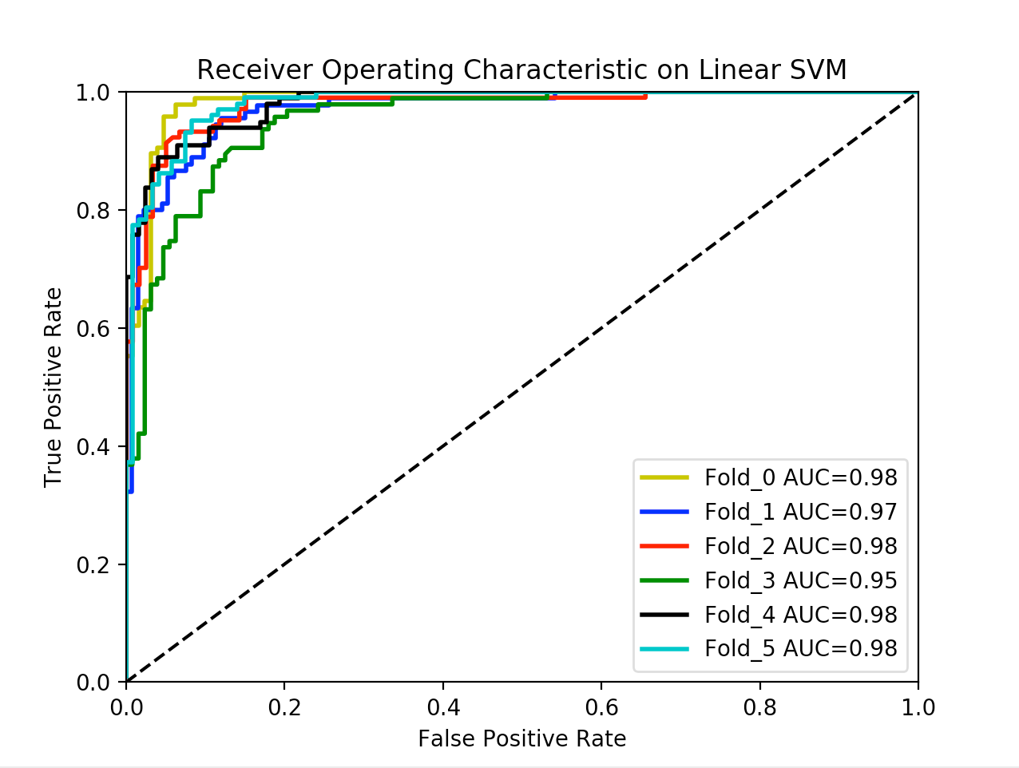
K fold validating
Every iteration, choose one part of data for testing, the other K-1 parts for training
Fold = 6, every part consists around 230 papers
Tf-Idf as the training sample
6 iterations
LinearSVM

Slide 8
K fold validating
ACCURACY | Fold 1 | Fold 2 | Fold 3 | Fold 4 | Fold 5 | Fold 6 | AVERAGE
BAYES | 0.879 | 0.865 | 0.838 | 0.892 | 0.816 | 0.820 | 0.851
LinearSVM | 0.933 | 0.915 | 0.897 | 0.901 | 0.919 | 0.897 | 0.910
F1-measure | Fold 1 | Fold 2 | Fold 3 | Fold 4 | Fold 5 | Fold 6 | AVERAGE
BAYES | 0.842 | 0.780 | 0.769 | 0.829 | 0.828 | 0.862 | 0.818
LinearSVM | 0.898 | 0.868 | 0.894 | 0.897 | 0.892 | 0.934 | 0.897

Slide 9
Parameter tuning
Is TF- IDF favorable here?
How about choose word group instead of single word in representation?
Grid search in the parameter space:
'vect__ngram_range': (1, 1), (1, 2)
'tfidf__use_idf': (True, False)
Make K-fold validation
Use accuracy as the goal

Slide 10
Parameter turing
gsf 0.913004484305 {'clf__alpha': 0.001, 'tfidf__use_idf': False, 'vect__ngram_range': (1, 2)}
gsf 0.921076233184 {'clf__alpha': 0.001, 'tfidf__use_idf': True, 'vect__ngram_range': (1, 2)}
gsf 0.905829596413 {'clf__alpha': 0.001, 'tfidf__use_idf': True, 'vect__ngram_range': (1, 2)}
gsf 0.904035874439 {'clf__alpha': 0.001, 'tfidf__use_idf': True, 'vect__ngram_range': (1, 2)}
gsf 0.904932735426 {'clf__alpha': 0.001, 'tfidf__use_idf': True, 'vect__ngram_range': (1, 2)}
gsf 0.905829596413 {'clf__alpha': 0.001, 'tfidf__use_idf': False, 'vect__ngram_range': (1, 2)}
Better Parameters: with tf-idf, and use 2-grams

Slide 11
THANKS!

